Slide 1


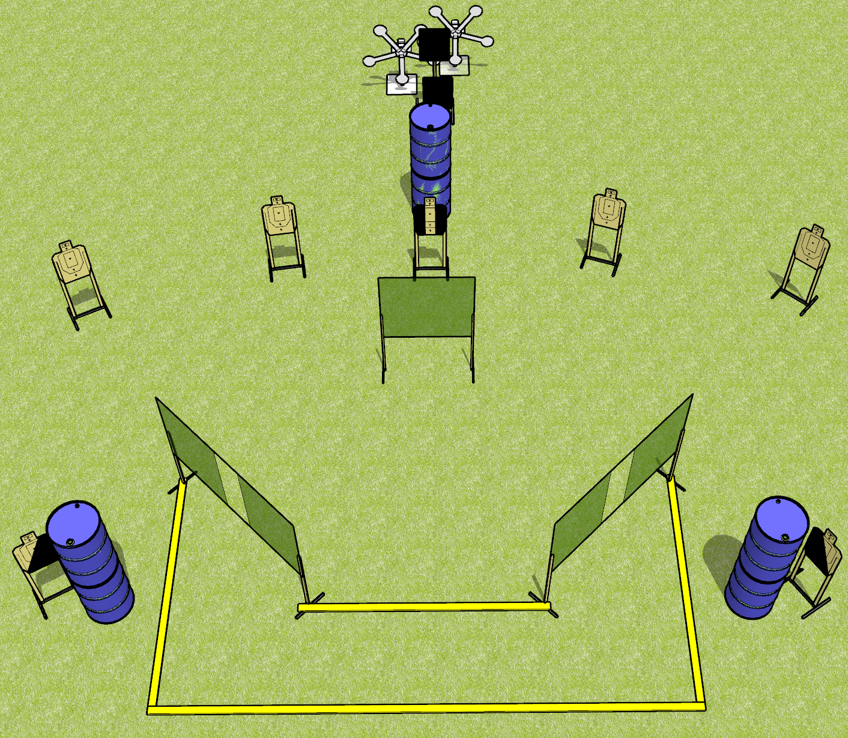
 | Dothan Gun Club – USPSA Match Double Trouble Course Designer : Drew Coleman
Round Count 24 rounds 7 USPSA 10 falling plates
Equipment List 6 wall feet 2 Texas stars 1 left + 1 right diag, 1 tux 4 targets

Slide 2
Double Trouble
Written Stage Briefing
Double Trouble is a 24 rounds, 120 point, Comstock course of fire. There are 7 USPSA targets and 10 falling plates. The best 2 hits on paper will score, and steel must fall to score. The start signal is audible.
Handgun start position is completely outside the shooting area, wrists below belt. Handgun is loaded and holstered.
PCC start position is completely outside the shooting area, stock on belt. Loaded carbine is held with both hands, safety on.
On start signal, engage targets as they become available from within the shooting area.

